Slide 1

Intro to SVG Part 3: Introducing paths

Slide 2

Rob Larsen
Rob is an experienced front-end engineer, author and open-source contributor.
Rob is co-author of Professional jQuery, the author of Beginning HTML and CSS, the author of The Uncertain Web, from O’Reilly, the author of Mastering SVG and co-author of The HTML and CSS Workshop.
A long-time open-source contributor, Rob currently maintains HTML5-Boilerplate and administers the H5BP organization on GitHub.

Slide 3
What we’ll cover
What the <path> element is and why it's the most important element in SVG.
How to read the commands in the powerful d attribute
Key commands for moving, drawing lines, and creating curves

Slide 4
The <path> element
Notes:
By far the most important element in SVG is <path>, which lets you draw virtually any line or shape using a series of vector commands passed to its d attribute. If you're doing anything complex in SVG, you're almost certainly using a path.
The <path> element's difficult syntax was a significant barrier to SVG's early adoption. The values in a d attribute can be incredibly dense and complicated, making it the hardest part of the spec to work with manually. The good news is, you don't have to. Complex paths are almost always generated by design software or helper libraries. That said, understanding the basics of paths is foundational to understanding SVG.
Just how complicated can paths get? Let's ook at the code used to render the "S" in the SVG logo.

Slide 5
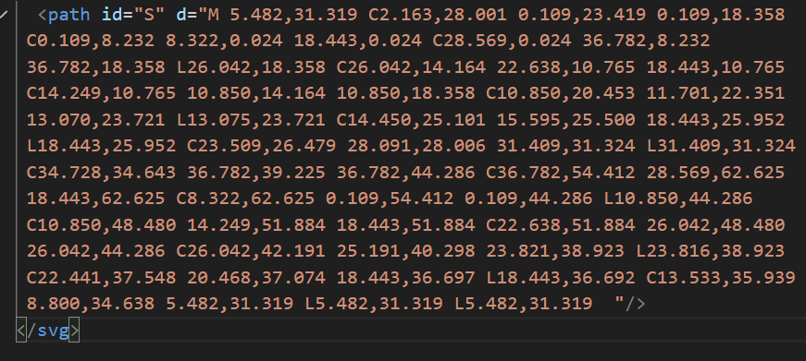
PAth.svg
Notes:
Without knowing what's going on, that's impossible to parse and even knowing the rules for command instructions passed to the d attribute it's difficult to keep track what’s going on here. This isn’t meant for human consumption.
There’s a logic there, which is why you can write tools that make the SVG magic happen. Thankfully no one is authoring this stuff by hand. This is in direct contrast to other SVG elements which are no more complicated than their HTML counterparts. We’ll be looking at those in the next episode in this series.
Let’s look at a simpler example to gain some understanding of the way paths work.

Slide 6

A Path you can Follow!

Slide 7
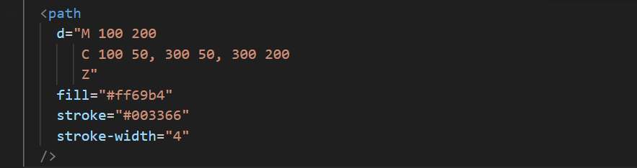
Simple-path.svg
Notes:
Let's look at a simpler example so that you can get your head around the syntax. In this
document, we’re creating a simple half circle. The three instructions are read as follows
M 100 200
Move to (100, 200): The path starts at the point (100, 200). This sets the starting position for the drawing.
C 100 50, 300 50, 300 200
C creates a Cubic Bézier Curve:
The curve starts at (100, 200).The first control point is at (100, 50).The second control point is at (300, 50).The curve ends at (300, 200).This creates a smooth, arching curve from the left to the right, passing above the starting and ending points.
Z Close Path: Draws a straight line from the current point (300, 200) back to the starting point (100, 200), closing the shape.

Slide 8
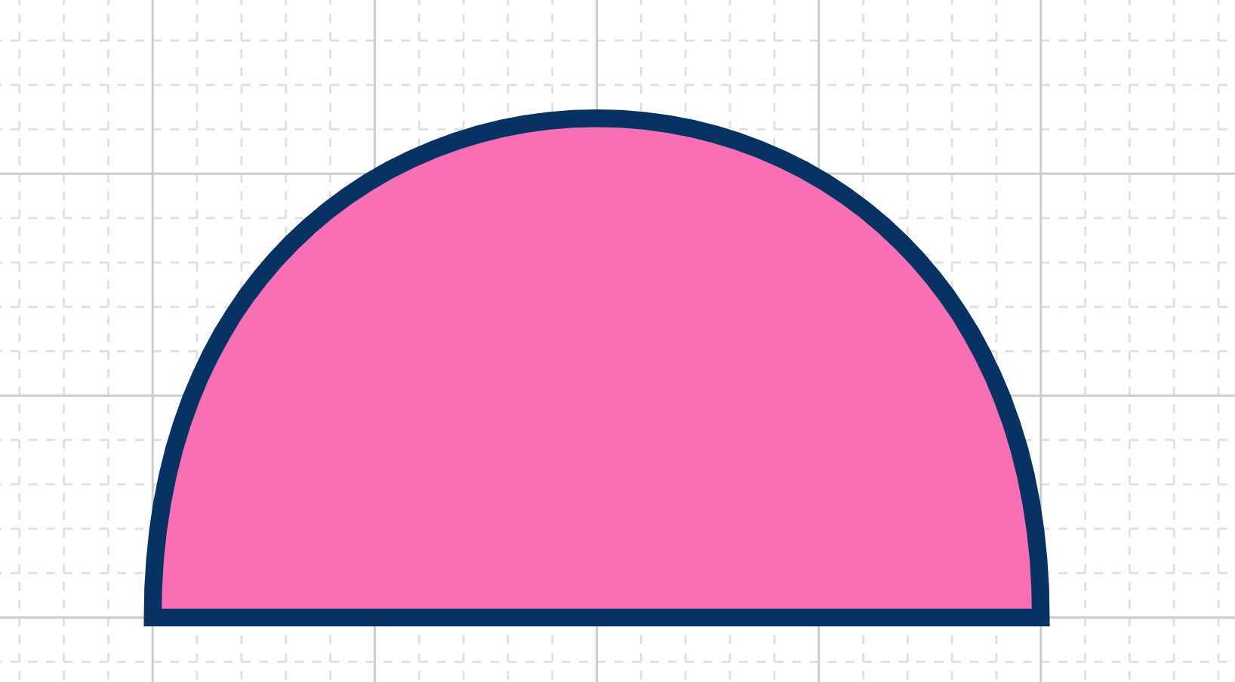
Simple-path.svg
Notes:
This is what the previous instructions draw

Slide 9
Bezier curves?
Notes:
If you’re wondering about Bezier curves… you’re in luck. I’m going to briefly describe them.
They are named after Photo of Pierre Bézier an engineer at Renault who was a pioneer in computer aided design

Slide 10
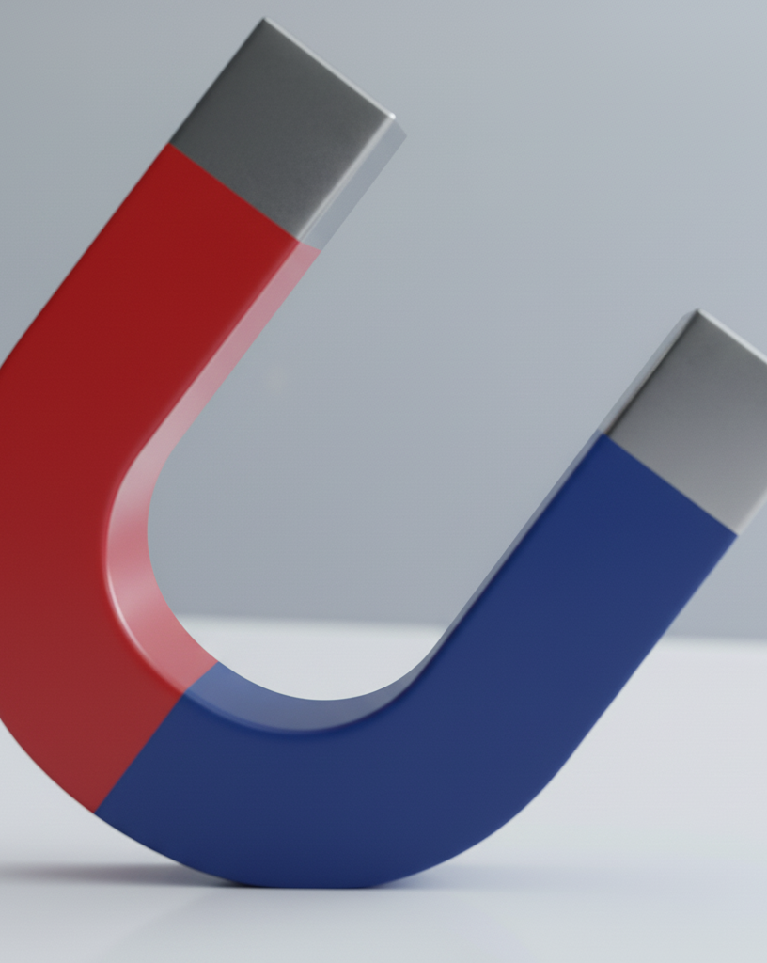
Bezier curves
In SVG, a Bézier curve is a smooth, curved line defined by a set of points. These points are not all on the curve itself; some act as "control points" that influence its shape.
There are two main types of points used to define a Bézier curve:
Anchor Points: These are the start and end points of the curve. The curve will always pass directly through these points.
Control Points: These are points that are not on the curve itself. They act like magnets, pulling the curve towards them and defining its shape, direction, and steepness. Think of them as handles you can pull to bend the line.
Notes:
In SVG, a Bézier curve is a smooth, curved line defined by a set of points. These points are not all on the curve itself; some act as "control points" that influence its shape.
There are two main types of points used to define a Bézier curve:
Anchor Points: These are the start and end points of the curve. The curve will always pass directly through these points.
Control Points: These are points that are not on the curve itself. They act like magnets, pulling the curve towards them and defining its shape, direction, and steepness. Think of them as handles you can pull to bend the line.

Slide 11
Bezier curve Control Points
How Control Points Work
The position of the control points determines the curve's tangent (the direction of the line as it leaves an anchor point) and its magnitude (how far the curve bends).
The line between an anchor point and its corresponding control point sets the initial direction of the curve.
The distance of the control point from the anchor point determines how much the curve bends. A control point further away creates a more pronounced, steeper curve.

Slide 12
Two Kinds of Bezier curves- Quadratic and Cubic
The defining difference between the two kinds of Bezier curves are in the number of control points that shape the curve.
A Quadratic Bézier Curve is defined by three points: a start point, an end point, and a single control point
A Cubic Bézier Curve is more complex, defined by four points: a start point, an end point, and two control points
Notes:
The defining difference between the two kinds of Bezier curves are in the number of control points that shape the curve.
A Quadratic Bézier Curve is defined by three points: a start point, an end point, and a single control point
A Cubic Bézier Curve is more complex, defined by four points: a start point, an end point, and two control points
What does that mean? Well, a Quadratic Bézier Curve, with only one control point, a quadratic curve can only form a simple, parabolic arc. The single control point pulls the curve towards it, dictating the bend's direction and magnitude. This simplicity makes them easier to work with but limits the variety of shapes they can create. They are always a segment of a parabola.
A Cubic Bézier Curve is more flexible. With two control points in a cubic Bézier curve you have significantly more control and flexibility. The first control point influences the direction of the curve as it leaves the start point.The second control point determines the direction of the curve as it approaches the end point. The distance of these control points from their respective endpoints affects the curve's curvature. This allows for the creation of more complex and nuanced shapes, including S-curves, which are impossible with a single quadratic curve.

Slide 13
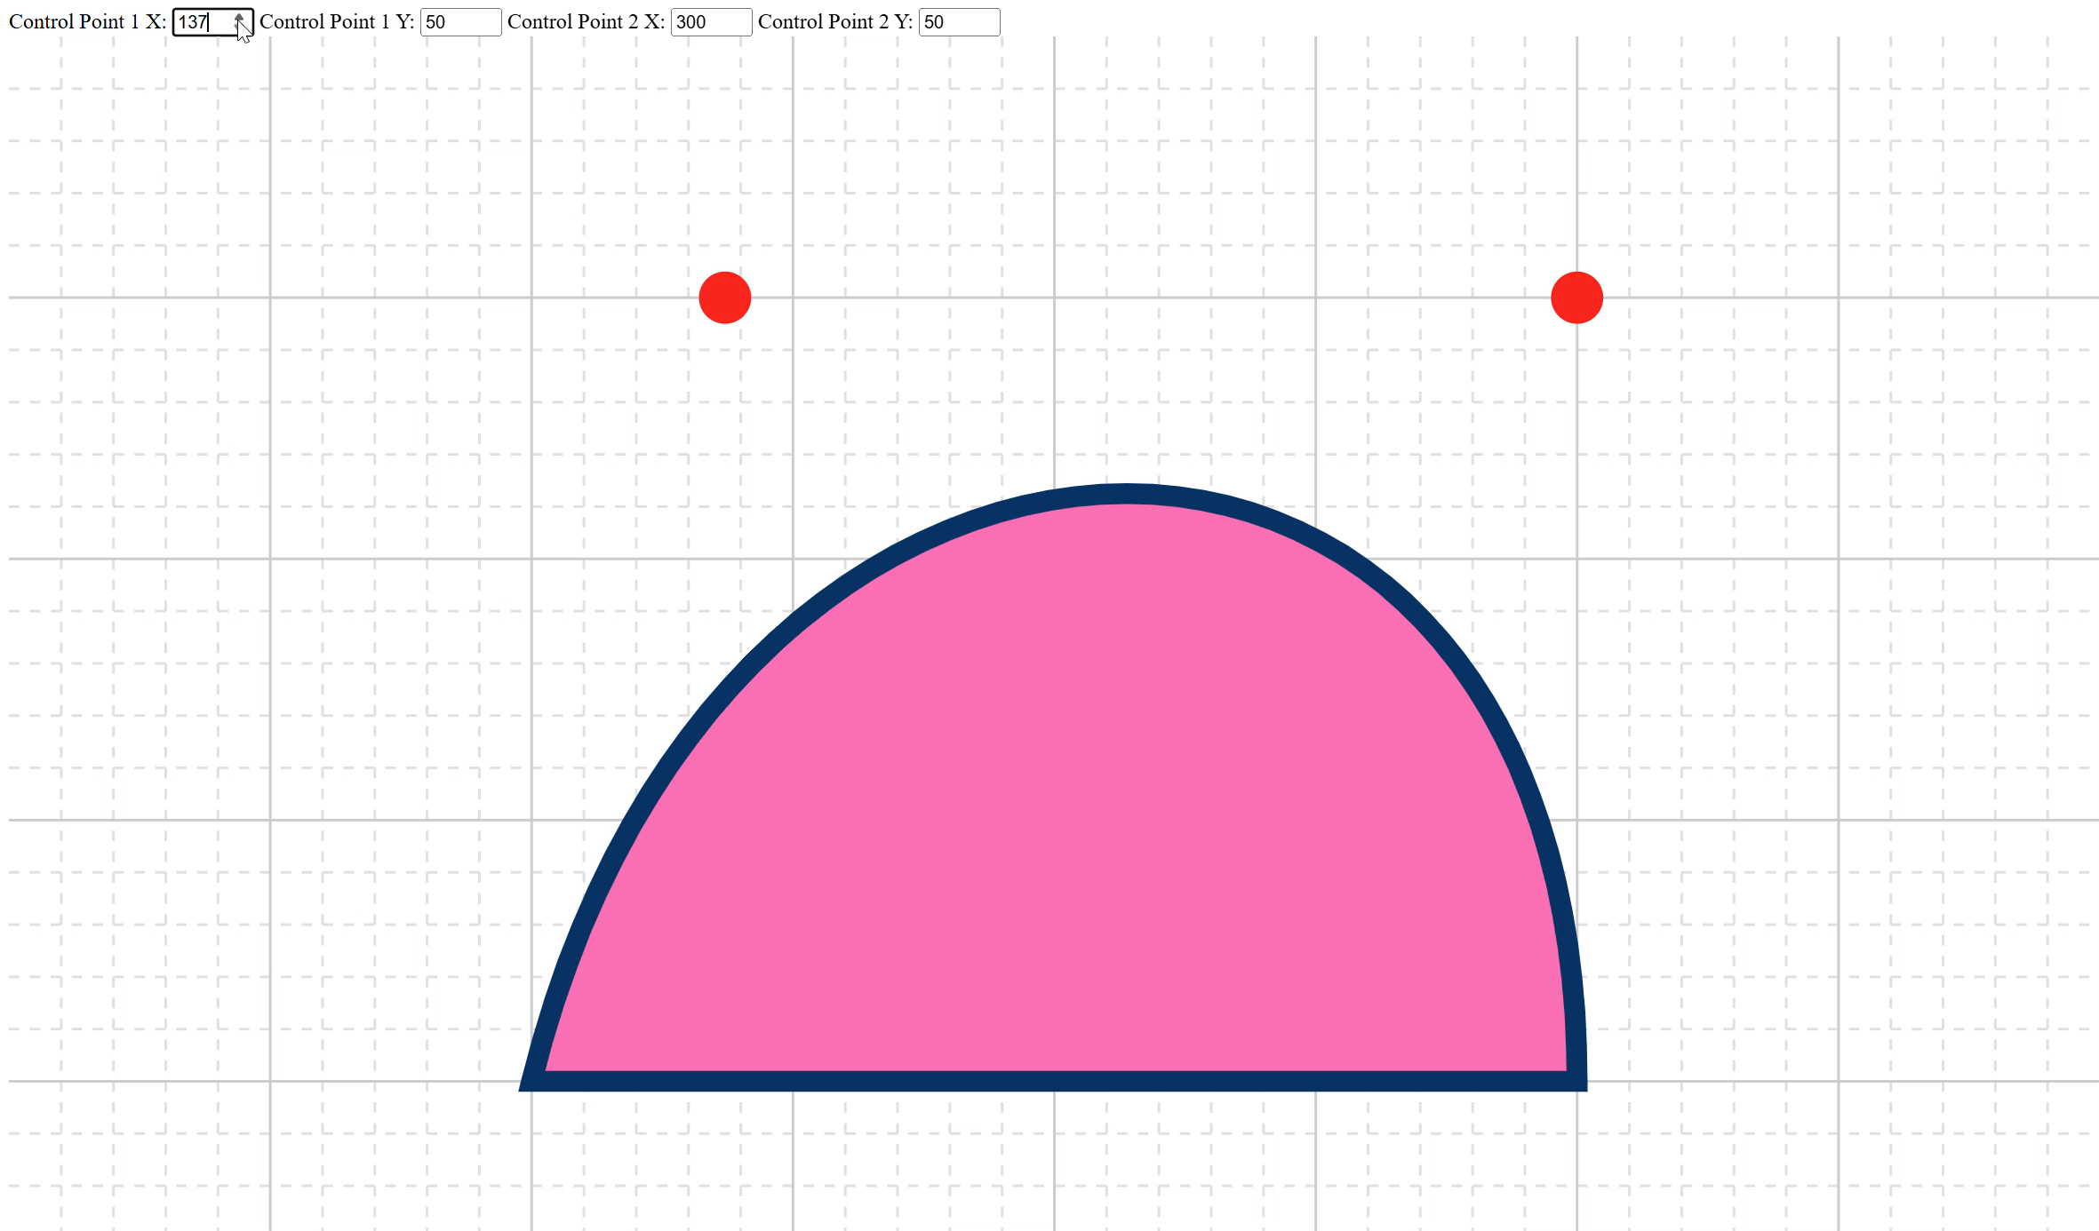
Control points (cubic)
Notes:
Theres a demo *link in the description” which will allow you to play with control points to get some sense of how they work. If you’ve done work in a vector graphics program like Illustrator this will be more familiar to you and the way the control points map to the shape of the curve should make some intuitive sense.
If not, this demo will help you see the relationship between control points and the shape of the curve.
You can see the “magnetic relationship” between the control points and the curve.
Please play around with it as well as it’s a useful demo, in this case illustrating the use of a cubic Bezier curve with two control points. Try it out yourself- you can create an S curve, as mentioned, just by manipulating the control points

Slide 14
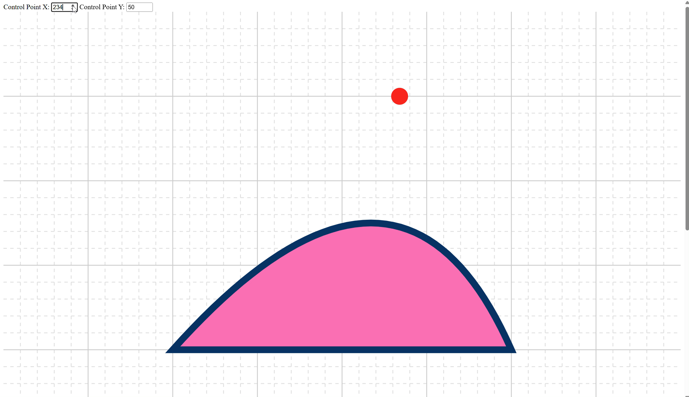
Control points (quadratic)
Notes:
Here’s a simpler demo illustrating the single control point of a quadratic bezier curve. You can see how it might be easier to work with but also has much less flexibility.

Slide 15
The path API
Notes:
While the audience for this series is by definition people getting started with SVG and therefore unlikely to be people jumping right in and scripting complex path elements, I would be failing in my job as an educator if I don’t at least define what you can do in a path element. I WILL return to the PATH element later in the series, when we’re beyond the true introductory topics, but for now this brief overview is likely all that you will need. For most of us, awareness of what tools like D3 are doing under the hood is enough. I’ve never had the need to do any in-depth debugging with the <path> element directly when using modern tools.

Slide 16
Command instructions
A key concept to remember is that each command comes in two forms:
Uppercase (e.g., L): Uses absolute coordinates, meaning the points are positioned relative to the SVG canvas's origin (0, 0).
Lowercase (e.g., l): Uses relative coordinates, meaning the points are positioned relative to the previous point in the path.

Slide 17
Command instructions - MOVETO
This command moves the "pen" to a new location without drawing a line. It's used to start a new subpath.
M (Absolute): Move to the coordinate (x, y).
m (Relative): Move by x horizontally and y vertically from the current position.

Slide 18
Command instructions - LINETO
These commands draw straight lines from the current position to a new position.
L(ineTo)
L (Absolute): Draw a line to the coordinate (x, y).
l (Relative): Draw a line from the current point to a point x and y away.
H(orizontal Lineto)
H (Absolute): Draw a horizontal line to the x-coordinate x.
h (Relative): Draw a horizontal line dx long.
V(ertical Lineto)
V (Absolute): Draw a vertical line to the y-coordinate y.
v (Relative): Draw a vertical line dy long.

Slide 19
Command instructions - CurveTo
Curveto (Bézier Curves)
These commands draw various types of Bézier curves.
C (Cubic Bézier)
Draws a curve to (x, y) using (x1, y1) as the control point for the start of the curve and (x2, y2) as the control point for the end.
S (Smooth Cubic Bézier)
A shortcut for stringing cubic curves together. It assumes the first control point is a reflection of the last control point used in the previous C or S command. (x2, y2) is the second control point, and (x, y) is the end point.
Q (Quadratic Bézier)
Draws a simpler curve to (x, y) using only one control point at (x1, y1).
T (Smooth Quadratic Bézier)
A shortcut for stringing quadratic curves together. It assumes the control point is a reflection of the control point from the previous Q or T command.
Notes:
Again, we’ll revisit paths and Bezier curves later on in this series, so I won’t go into more detail than this now. You can do a lot with SVG letting the tools handle this stuff. But! Knowing what’s going on is important as you learn more about SVG- especially if you’re writing custom tools or visualizations.

Slide 20
What we’ve learned
Key takeaways
The <path> element is the most important in SVG, allowing you to draw anything using vector commands.
Path instructions are passed into the d attribute, which can be dense and difficult to read manually.
We can create shapes by using commands like M (Move), L (Line), and C (cubic Bézier curve).
Complex paths are typically generated by software or JavaScript, so understanding the syntax is important but you will generally use tools to generate paths

Slide 21
THANK YOU
Rob Larsen
https://htmlcssjavascript.com
https://github.com/roblarsen
https://www.linkedin.com/in/robreact/
Code and slides:
https://github.com/roblarsen/introduction-to-svg

